Slide 1
Oracle Data Definition Language (DDL)
*Data types
* Constraints

Slide 2
Oracle
Learn about Data Definition Language (DDL) statements to work with the structure of an Oracle database table.
  Various data types used in defining columns in a database table.
  Integrity and value constraints
  Viewing, modifying, and removing a table structure.

Slide 3
NAMING RULES AND CONVENTIONS
A table is an object that can store data in an Oracle database.
When you create a table, you must specify
  the table name,
  the name of each column,
  the data type of each column,
  and the size of each column.

Slide 4
NAMING RULES AND CONVENTIONS
Oracle provides you with different constraints
  to specify a primary or a composite key for the table,
  to define a foreign key in a table that references a primary key in another table,
  to set data validation rules for each column,
  to specify whether a column allows NULL values,
  and to specify if a column should have unique values only.

Slide 5
Data Types
When a table is created, each column in the table is assigned a data type.
Some important data types:
  Varchar2
  Char
  Number

Slide 6
Varchar2
The VARCHAR2 type is a character data type to store variable-length alphanumeric data in a column.
The size is specified within parentheses, for example, VARCHAR2(20).
If the data are smaller than the specified size, only the data value is stored, and trailing spaces are not added to the value.
VARCHAR2 is the most appropriate type for a column whose values do not have a fixed length.

Slide 7
Char
The CHAR type is a character data type to store fixed-length alphanumeric data in a column.
The CHAR data type uses the storage more efficiently and processes data faster than the VARCHAR2 type.

Slide 8
Number
The NUMBER data type is used to store negative, positive, integer, fixed-decimal, and floating-point numbers.
When a number type is used for a column, its precision and scale can be specified.
  Precision is the total number of significant digits in the number, both to the left and to the right of the decimal point.
  Scale is the total number of digits to the right of the decimal point.

Slide 9
Number -- integer
An integer is a whole number without any decimal part.
The data type for it would be defined as NUMBER(3), where 3 represents the maximum number of digits.

Slide 10
Number – fixed-point
decimal number has a specific number of digits to the right of the decimal point.
The PRICE column has values in dollars and cents, which requires two decimal places - for example, values like 2.95, 3.99, 24.99, and so on.
If it is defined as NUMBER(4,2), the first number specifies the precision and the second number the scale.

Slide 11
Number – floating-point
A floating-point decimal number has a variable number of decimal places
To define such a column, do not specify the scale or precision along with the NUMBER type.
By defining a column as a floating-point number, a value can be stored in it with very high precision

Slide 12
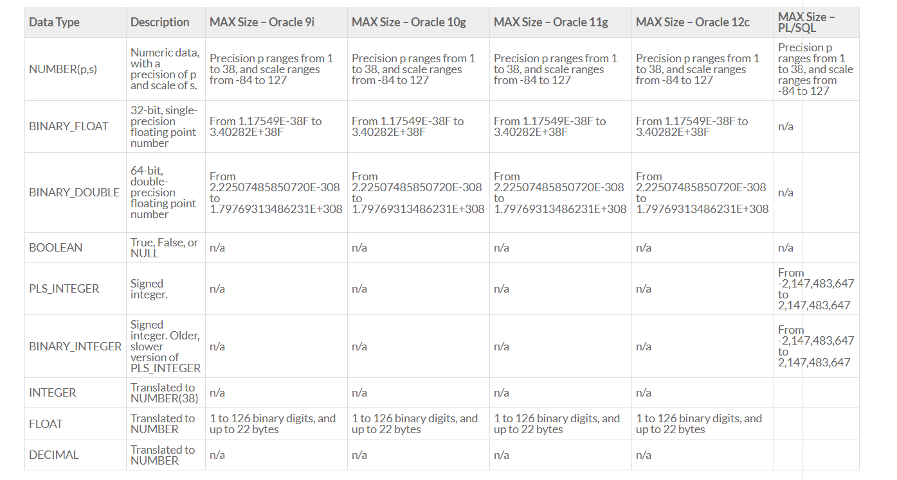
Numbers

Slide 13
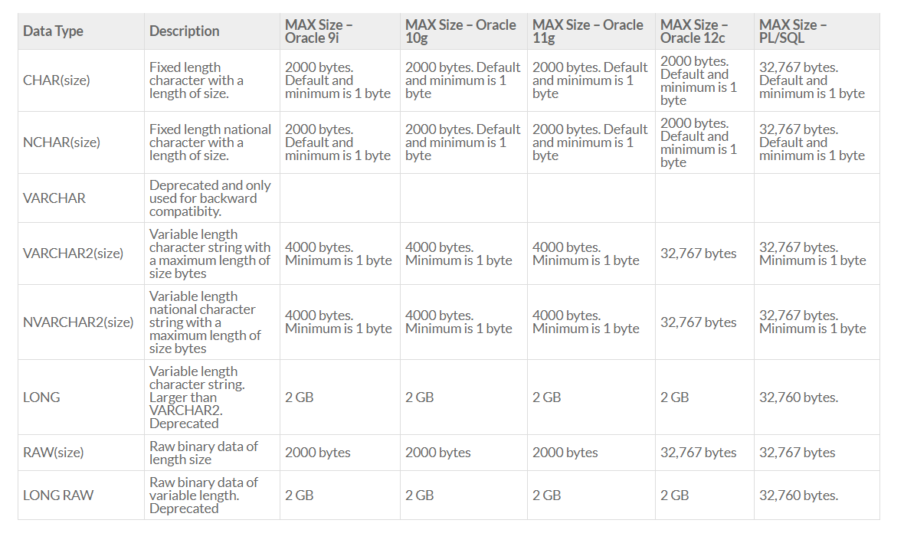
Characters/Text

Slide 14
Types of Constraints
There are two types of constraints:
1. Integrity constraints: define both the primary key and the foreign key with the table and primary key it references.
2. Value constraints: define if NULL values are disallowed, if UNIQUE values are required, and if only certain set of values are allowed in a column.

Slide 15
Naming a Constraint
The general convention used for naming constraints is
<table name>_<column name>_<constraint type>
  table name is the name of the table where the constraint is being defined,
  column name is the name of the column to which the constraint applies,
  and constraint type is an abbreviation used to identify the constraint’s type.

Slide 16
Naming a Constraint
For example, a constraint name emp_deptno_fk refers to:
a constraint in table EMP on column DeptNo of type foreign key. A constraint name dept_deptno_pk is for a primary key constraint in table DEPT on column DeptNo.

Slide 17
Popular Constraint abbreviations
Primary Key pk
Foreign Key fk
Unique uk
Check ck
Not Null nn

Slide 18
Defining a Constraint
A constraint can be created at the same time the table is created, or it can be added to the table afterward. There are two levels where a constraint is defined:
  Column level.
  Table level.

Slide 19
Column level
A column-level constraint references a single column and is defined along with the definition of the column.
Any constraint can be defined at the column level except for a FOREIGN KEY and COMPOSITE primary key constraints.
Column datatype [CONSTRAINT constraint_name] constraint_type
Example:
Building VARCHAR2(7) CONSTRAINT location_building_nn NOT NULL

Slide 20
Table level
A table-level constraint references one or more columns and is defined separately from the definitions of the columns.
Normally, it is written after all columns are defined.
All constraints can be defined at the table level except for the NOT NULL constraint.
[CONSTRAINT constraint_name] constraint_typ (Column, . . .),
Example:
CONSTRAIN location_roomid_pk PRIMARY KEY(Roomid)

Slide 21
The Primary Key Constrain
The PRIMARY KEY constraint is also known as the entity integrity constraint
It creates a primary key for the table. A table can have only one primary key constraint.
If a table uses more than one column as its primary key (i.e., a composite key), the key can only be declared at the table level.

Slide 22
The Primary Key Constrain
At the column level, the constraints is defined by
DeptId NUMBER (2) CONSTRAINT dept_deptid_pk PRIMARY KEY,
At the table level, the constraint is defined by
CONSTRAINT dept_deptid_pk PRIMARY KEY(DeptId),

Slide 23
The FOREIGN KEY Constraint
The FOREIGN KEY constraint is also known as the referential integrity constraint.
It uses a column or columns as a foreign key, and it establishes a relationship with the primary key of the same or another table.

Slide 24
The FOREIGN KEY Constraint
To establish a foreign key in a table, the other referenced table and its primary key must already exist.
Foreign key and referenced primary key columns need not have the same name, but a foreign key value must match the value in the parent table’s primary key value or be NULL

Slide 25
The FOREIGN KEY Constraint
At the table level ONLY
CONSTRAINT student_facultyid_fk FOREIGN KEY(FacultyId)
REFERENCES faculty (FacultyId),

Slide 26
The NOT NULL Constraint
The NOT NULL constraint ensures that the column has a value and the value is not a null value
A space or a numeric zero is not a null value
At the column level ONLY, the constraint is defined by:
Name VARCHAR2(15) CONSTRAINT faculty_name_nn NOT NULL,

Slide 27
The UNIQUE Constraint
The UNIQUE constraint requires that every value in a column or set of columns be unique.
At the table level, the constraint is defined by
CONSTRAINT dept_deptname_uk UNIQUE(DeptName),
At the column level, the constraint is defined by:
DeptName VARCHAR2(12) CONSTRAINT dept_deptname_uk UNIQUE,

Slide 28
The CHECK Constraint
The CHECK constraint defines a condition that every row must satisfy
At the column level, the constraint is defined by
DeptId NUMBER(2) CONSTRAINT dept_deptid_cc
CHECK((DeptId >= 10) and (DeptId <= 99)),
At the table level, the constraint is defined by:
CONSTRAINT dept_deptid_cc
CHECK((DeptId >= 10) and (DeptId <= 99)),

Slide 29
CREATING AN ORACLE TABLE
A table is created as soon as the CREATE statement is
successfully executed by the Oracle server. The general
syntax of CREATE TABLE statement is
CREATE TABLE [schema.] tablename
(column1 datatype [CONSTRAINT constraint_name] constraint_type . . .,
(column2 datatype [CONSTRAINT constraint_name] constraint_type,
[CONSTRAINT constraint_name] constraint_type (column, . . . ), . . . );

Slide 30
Create Table example
CREATE TABLE student
(StudentId CHAR (5),
Last VARCHAR2 (15) CONSTRAINT student_last_nn NOT NULL,
First VARCHAR2 (15) CONSTRAINT student_first_nn NOT NULL,
Street VARCHAR2 (25),
City VARCHAR2 (15),
State CHAR (2) DEFAULT 'NJ',
Zip CHAR (5),
StartTerm CHAR (4),
BirthDate DATE,
FacultyId NUMBER (3),
MajorId NUMBER (3),
Phone CHAR (10),
CONSTRAINT student_studentid_pk PRIMARY KEY (StudentID));

Slide 31
Viewing a Table’s Structure
The SQL*Plus command to view a table’s structure is DESCRIBE, which does not need a semicolon at the end because it is not a SQL statement.
SQL> DESCRIBE student

Slide 32
Adding a New Column to an Existing Table
The general syntax to add a column to an existing table is
ALTER TABLE tablename
ADD columnname datatype;
SQL> ALTER TABLE student 2 ADD SocialSecurity CHAR(9); Table altered. SQL>

Slide 33
Modifying an Existing Column
The general syntax to modify an existing column is
ALTER TABLE tablename
MODIFY columnname newdatatype;
where newdatatype is the new data type or the new size for the column.
SQL> ALTER TABLE student 2 MODIFY SocialSecurity VARCHAR2(11); Table altered. SQL>

Slide 34
Adding a Constraint
To add a constraint using ALTER TABLE, the syntax for table level constraint is used. The general syntax of ALTER TABLE is
ALTER TABLE tablename
ADD [CONSTRAINT constraint_name] constraint_type (column, …),
SQL> ALTER TABLE COURSE 2 ADD CONSTRAINT COURSE_PREREQ_FK FOREIGN KEY (PREREQ) 3 REFERENCES COURSE(COURSEID); Table altered. SQL>

Slide 35
Displaying Table Information
When a user creates a table or many tables in the database, Oracle tracks them using its own data dictionary
Viewing a User’s Table Names
SELECT TABLE_NAME FROM USER_TABLES;
To display all information:
SELECT * FROM USER_TABLES;

Slide 36
Dropping a Column
The general syntax is
ALTER TABLE tablename DROP COLUMN columnname;

Slide 37
Dropping a Table
The general syntax is
DROP TABLE tablename [CASCADE CONSTRAINTS];
For example,
DROP TABLE sample;
Oracle displays a “Table dropped” message when a table is successfully dropped.
If you add optional CASCADE CONSTRAINTS clause, it removes foreign key references to the table also.

